Slide 1
5 Essentials for Market Success
Banana Ripeness Classification System
A concise future-facing business view of the FYP project.
A market-oriented pitching deck for a real-time vision-based prototype that classifies banana ripeness under lighting variation.
01
02
03
Current Stage
Prototype & testing stage
Market & Competitive Analysis
Uniqueness / Unique Selling Point
Target Market & Go-to-Market
Core Tech
YOLO-based classification + image preprocessing
Best Practical Method
Method 3 (Isolated + CLAHE)
04
05
Investment & Innovation Roadmap
Prototype / Demo & Future Direction
Banana Ripeness Classification | Market Success Deck

Slide 2
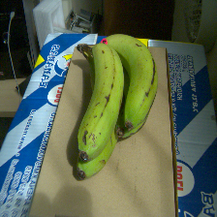
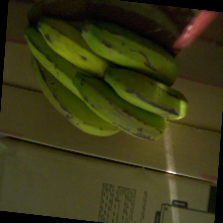
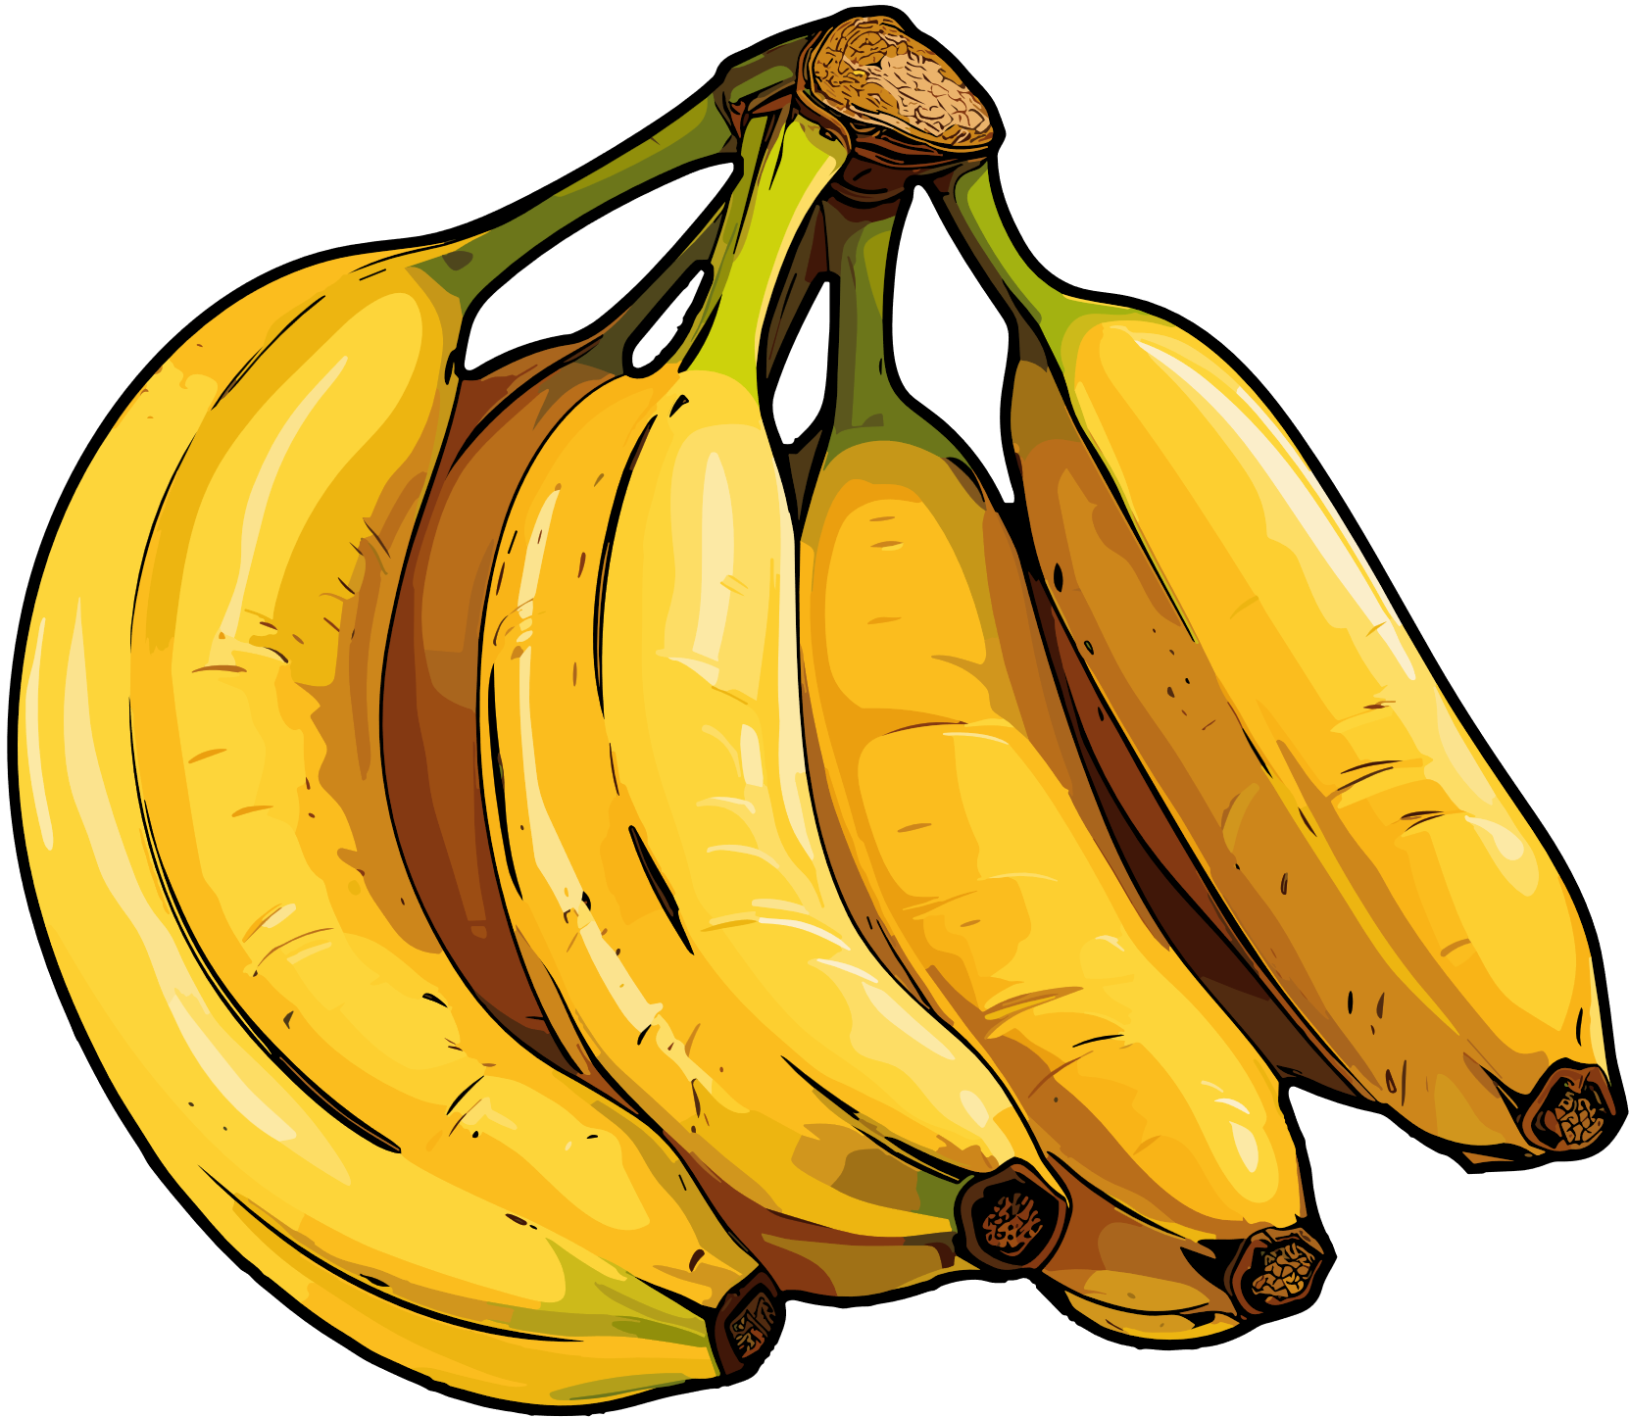
00
Problem & Current Solutions
The practical challenge behind banana ripeness classification
Complex Background
Lighting Variation
Problem
How can banana ripeness be detected reliably in practical conditions?
Background interference and lighting variation may reduce the reliability of banana ripeness classification.

Slide 3
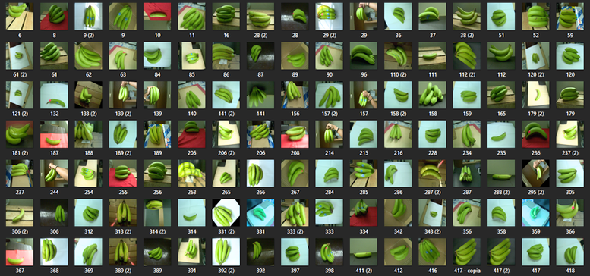
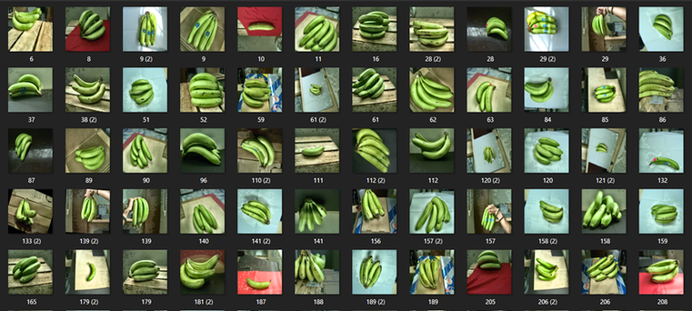
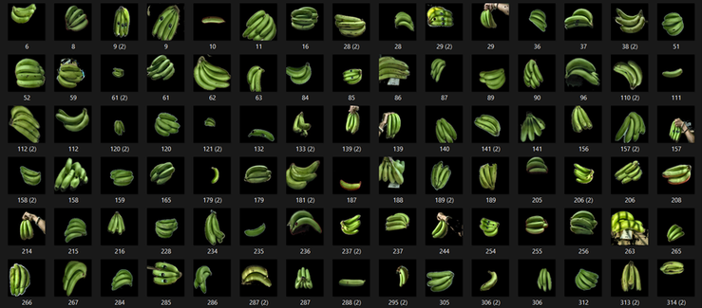
00
Dataset Preparation Methods
Visual differences between the three image-input methods
Method 1 Raw
Method 2 Masked + CLAHE
Method 3 Isolated + CLAHE
Original images with natural background and lighting variation.
Banana region emphasized with moderate background suppression.
Background isolated to focus the model on the banana object.
The project compares three dataset preparation methods under fair and consistent settings.

Slide 4
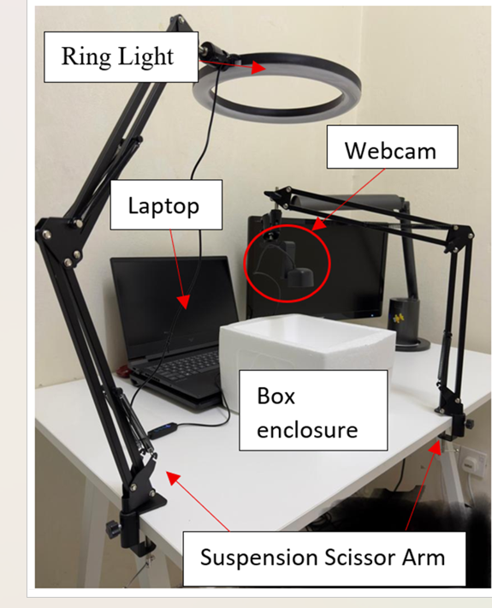
00
Design & Methodology — Hardware System
Physical setup used for real-time banana ripeness testing
Main components
Main components
Webcam
Captures live banana images for classification.
Ring light
Provides warm and cool lighting conditions for testing.
Box enclosure
Creates a more controlled capture environment.
Laptop + scissor arm
Runs the model and keeps the camera position stable.
Purpose: evaluate the trained models in a practical live-camera setup.

Slide 5
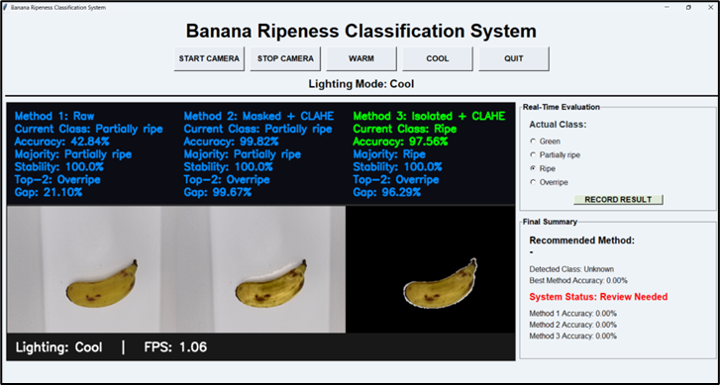
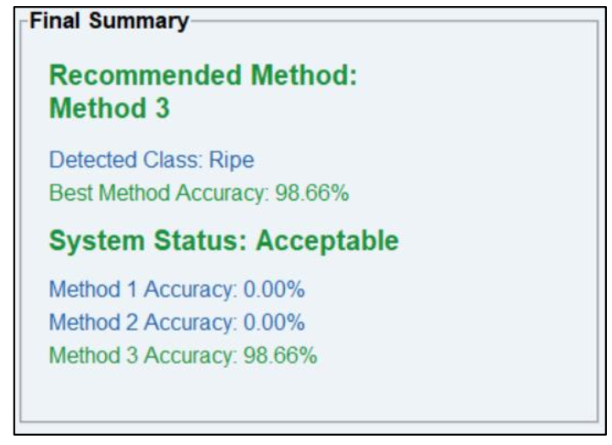
00
Design & Methodology — Real-Time GUI Platform
Custom interface for live comparison under warm and cool lighting
Live comparison
Real-time evaluation
Recording function

Slide 6
01
Market & Competitive Analysis
Why the problem matters and how this prototype compares to existing approaches
Competitive landscape
Market Need
Fruit grading is still often manual, subjective, and inconsistent.
Lighting variation can change the perceived banana colour and affect judgement.
In supermarkets and retail chains, inaccurate grading may lead to food waste or poor stock rotation.
A low-cost vision system can support more consistent ripeness assessment.
Approach
What they do
Limitation
Our Position
Manual inspection
Visual ripeness checking by workers
Subjective, inconsistent
Our system improves consistency
Colour chart / rule-based grading
Basic peel-colour judgement
Sensitive to lighting/background
More robust under lighting variation
TOMRA Food
Industrial fruit sorting and grading
Larger-scale, higher-cost focus
Lower-cost prototype direction
Ellips
AI-powered produce grading
Industrial line deployment focus
Simpler prototype for early-stage use
My Project
Our System
Market Focus
What our system does
Our position / advantage
Real Time Banana Ripeness Classification System
Supermarket quality monitoring and practical ripeness assessment
YOLO-based real-time ripeness classification under lighting variation
Lower-cost prototype with practical deployment direction
Banana Ripeness Classification | Market Success Deck

Slide 7
02
Uniqueness / Unique Selling Point
What makes the prototype different and valuable
Core Value
01 Real-time & visual
Live webcam GUI shows prediction results for three methods side-by-side.
A low-cost, real-time banana ripeness classification prototype that was tested under lighting variation to identify the most practical preprocessing method.
02 Lighting-aware testing
The project explicitly evaluates warm and cool lighting, which is important for practical use.
03 Method-driven insight
It does not only classify bananas — it identifies which preprocessing strategy works best.
Best practical outcome: Method 3 for real-time deployment
04 Low-cost deployment potential
Uses accessible components and can be extended into a simple application in the future.
Banana Ripeness Classification | Market Success Deck

Slide 8
03
Target Market & Go-to-Market Strategy
Who may benefit first and how the project can grow from prototype to pilot
Target users
Go-to-market path
Supermarkets / retailers
Need more consistent fruit quality checking and stock rotation.
Step 4
Offer as a low-cost decision-support tool or service package.
Fruit distributors / packing houses
Need faster preliminary sorting support before sale or shipment.
Step 3
Run small trials with supermarkets or fruit vendors and collect feedback.
Small farms / agri startups
Need an affordable ripeness screening tool without expensive hardware.
Step 2
Convert the research GUI into a simpler operator-friendly application.
Researchers / students
Can use the prototype as a testbed for further smart agriculture work.
Step 1
Pilot the prototype in a controlled fruit-checking setup.
Early positioning: a practical decision-support solution, not yet a fully commercial product.
Banana Ripeness Classification | Market Success Deck

Slide 9
04
Cost Analysis & Budget Value
Estimated prototype cost structure for the current FYP setup
ACHIEVED — PROTOTYPE VALIDATED
4 Classes
3 Methods
2 Lighting Modes
Best Practical Method
Green, Partially ripe, Ripe, Overripe
Raw, Masked + CLAHE, Isolated + CLAHE
Warm and cool real-time testing
Method 3 selected for real-time use
Estimated prototype cost
Why this project is budget-friendly?
Item
Description
Estimated Cost (RM)
Main strength: low-cost hardware with open-source software
Webcam
Dell WB3023 / similar camera
262 – 370
Ring light
Warm & cool lighting setup
20 – 50
Uses consumer-grade components instead of industrial machine-vision hardware.
No expensive proprietary software is required at prototype stage.
Suitable for early testing, student research, and pilot discussions.
Box enclosure
Controlled image capture area
20 – 50
Scissor arm / mount
Stable camera positioning
23 – 69
Software stack
Python, OpenCV, YOLO tools
0
Prototype total
Excluding laptop
325 – 539
Banana Ripeness Classification | Cost Analysis

Slide 10
05
Roadmap + Future Direction
How the project can grow from prototype to pilot
Future Direction
Development roadmap
Phase 3
Standalone app or commercial-ready package
Expand the dataset with more real-world lighting and background variation.
Develop a more practical mobile application for banana ripeness classification based on Method 3 preprocessing.
Conduct pilot testing in supermarket or fruit-handling environments.
Improve the system packaging as a more practical low-cost ripeness decision-support tool.
Phase 2
Pilot test in supermarket
Phase 1
Improve dataset and software usability
Now
Prototype validated with offline & real-time tests
Deployment Direction: Method 3 is the most practical foundation for future deployment.
Banana Ripeness Classification | 5-minute Summary Deck

Slide 11
Video DEMO

Slide 12
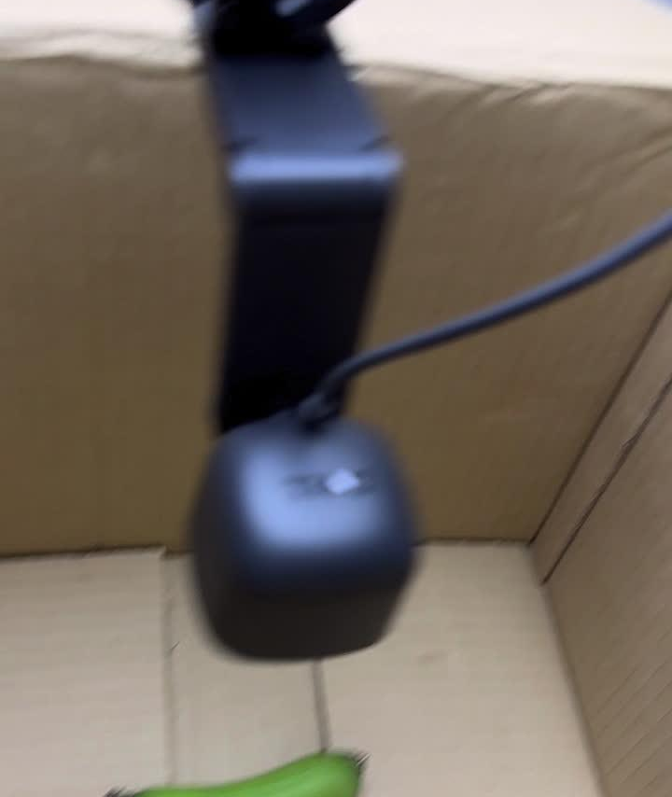
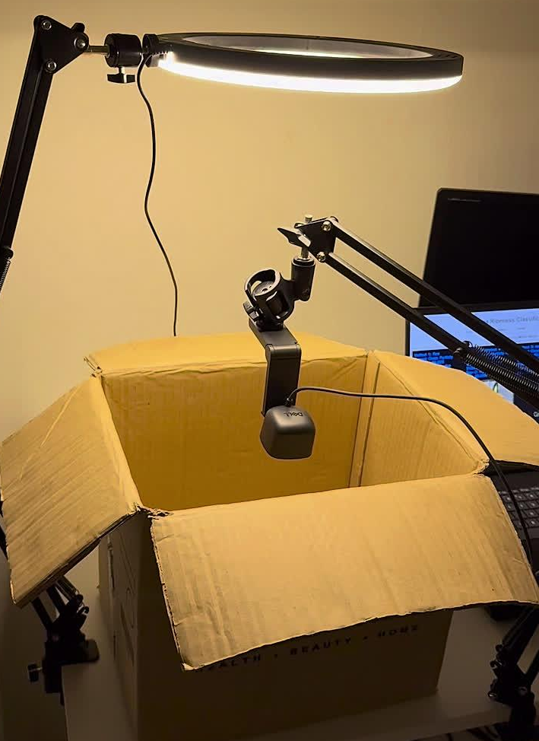
Unripe Banana Video
Partially-Ripe Banana Video

Slide 13
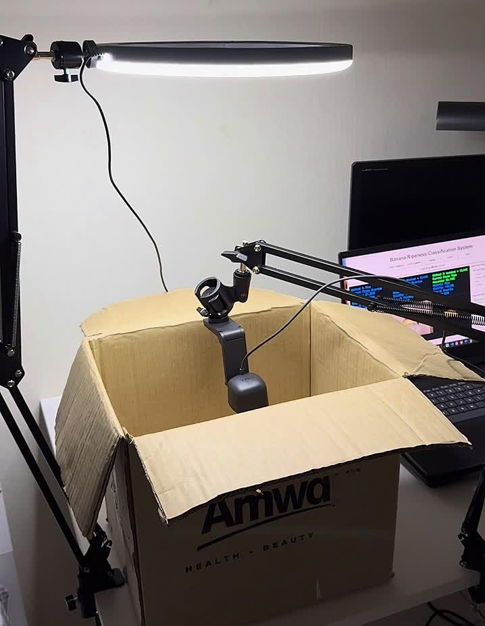
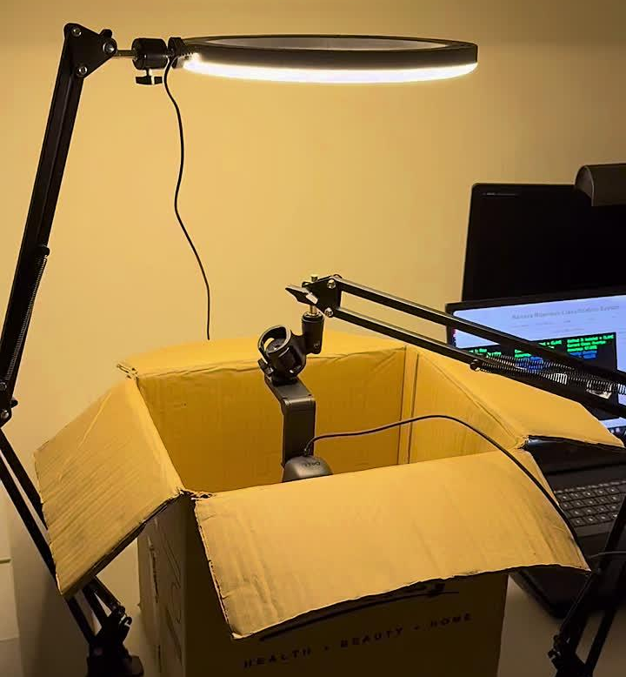
Ripe Banana Video
Overripe Banana Video

